Slide 1
TECH IN ISRAEL
BEHIND THE SCENES OF THE THRIVING STARTUP COMMUNITY

Slide 2



STARTUP COMMUNITY
Government Support
IDF Network
Israeli Culture
Government funding and legislation to support growing businesses has been crucial to the tremendous success of Israeli tech startups
Israeli Defense Force training places soldiers in high-risk problem solving situations, improving collaborability and understanding of cutting-edge technology.
A culture full of mentorship and entrepreneurial spirit is a big factor for Israel’s impressive progression into a world tech hub.

Slide 3
GOVERNMENT SUPPORT
Government’s confidence in risky investments paves the way for private funding to follow
Tnufa National Pre-Seed Fund
Grant awarded to Israeli companies in the ideation phase to explore innovative technology
Companies can receive up to NIS 200,000 (~$60,000 USD) over the course of two years
Foreign entrepreneurs are eligible as well, granted they can obtain a visa in Israel
Israel Innovation Authority
In 2019, NIS 1.7 Billion (~$480 million) allocated mostly to funding young startups

Slide 4
ISRAELI DEFENSE FORCE (IDF)
It’s not all about you.
Military training creates a bigger-picture perspective and is invaluable in a collaborative environment
Veterans from the IDF’s highly-specialized divisions are very well-equipped to enter the entrepreneurial world with their technical expertise
Soft skills are just as valuable in a startup environment
Teamwork and goal-oriented mindset instilled in soldiers

Slide 5
ISRAELI CULTURE
“Don’t think outside of the box, get rid of the box”
Embracing chutzpah
A characteristic of someone who has is willing to do or say things that others might find surprising, shocking, or even aggravating; fearlessness
Many Israeli startups are created to solve a problem that Israeli society faces
Big current traffic problems → Waze, Waycare, NoTraffic
Israeli impatience + innovative thinking
= unique solutions

Slide 6
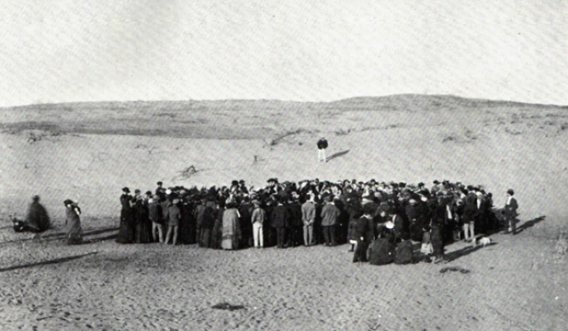

ISRAELI CULTURE
Tel-Aviv, 1948
Tel-Aviv, 2018

Slide 7








SUCCESSFUL COMPANIES

Slide 8

SUCCESSFUL COMPANIES
Privately-held startups valued at $1+ billion
Industry giants love investing in these companies
Dell, Microsoft, Google, etc.
Rapidly developing VC environment helps these startups get funding in early stages
80% of startups fail; to reach a billion dollar valuation is very rare
Saturated Israeli startup ecosystem still sees a few new ones every year
Tech Unicorns

Slide 9


GLOBAL TECH COMMUNITY
Startups per Capita
Israel is #1 in:
6,000+ startups in Israel (1 for every 1,400 people). 1,100 to 1,380 startups are established in Israel every year.
Scientists/Engineers per Capita
Credited to a highly-educated workforce; 140 scientists/technicians and 135 engineers for every 10,000 employees.
VC Investments per Capita
$6.4 billion raised in 2019 compared to $4.75 billion in 2018 and $1.13 billion in 2010. A huge economic incentive for startup growth.

